Slide 1
FEATURE SCALING
-SAI RAJ

Slide 2
FEATURE SCALING
Feature scaling is one of the most important data preprocessing
step in machine learning.
Algorithms that compute the distance between the features are
biased towards numerically larger values if the data is not scaled.
Also, feature scaling helps machine learning and deep learning
algorithms train and converge faster.
Some of the algorithms where we use the concept of feature
scaling are
KNN ,K Means Clustering, Deep Learning based algorithm etc

Slide 3
Feature scaling techniques:
Normalization
2.Standardization

Slide 4
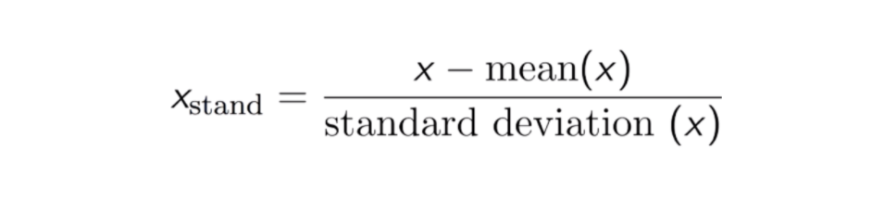
Normalization or min-max scaling:
Normalization is a scaling technique in which values are shifted and
rescaled so that they end up ranging between 0 and 1. and it is useful
for classification algorithm
Normalization is also known as min – max sclaing

Slide 5
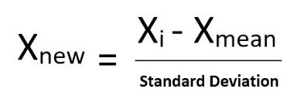
Standardization:
Standardization is the transformation of features by subtracting from
mean and dividing by standard deviation.
it is also known as z-score normalization
Standardization helps to scale down feature based on standard
normal distribution

Slide 6
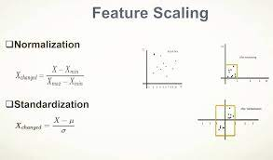

Slide 7
Thank you

